Slide 1
OTCBB: PRHL
“Everything Energy”
Randall Letcavage, President & CEO
FSX PRESENTATION
1382 Valencia Avenue •Suite F •Tustin• CA 92780 •Tel: 949.260.8070
www.PRHLcorp.com

Slide 2
What Does PRHL Do?
About Premier Holding Corp.
The company provides financial support and management expertise, which includes access to capital, financing, legal, insurance, mergers, acquisitions, joint ventures, and management strategies. The Companies strategy is to acquire clean technology companies and green products and services that are accretive and that can be seamlessly integrated. Through subsidiaries we offer renewable energy production, energy efficiency products and services to commercial middle-market companies, Fortune 500 brands, developers and management companies of large-scale residential developments. Additional integrated business offerings include direct energy services such as power purchase agreements (PPAs), energy financing and leasing of generation programs in urban and rural real estate environments, lighting efficiency systems and refrigeration systems. In essence Premier will use its overall expertise to create a Parent Company and subsidiaries to provide “Everything Energy” to its clients.

Slide 3
Premier Today
“Everything Energy”
“E^{3”}

Slide 4
Who We Are
Randall Letcavage: Chairman, CEO, President
Mr. Letcavage has recently been named Chairman, CEO, and President of Premier Holding Corp! He brings in excess of 25 years plus of business experience specializing in the financial markets and business consulting and green energy/clean technology. For the past 20 years Mr. Letcavage has been an investment banker widely recognized for individual achievements as well as his role of Founder, Officer and Director of the iCapital Group that includes iCapital Finance Inc, iCapital Advisory LLC and iCap Development LLC (A National “CDE” Community Development Entity – Certified by the U.S Treasury Department). Mr. Letcavage has also held executive positions, invested, and/or operated numerous businesses including related companies in “Power Generation and Power Reduction” – CEO of Ciralight Global Inc, CEO of Green Central Holdings, Consultant and second largest shareholder of publicly traded PRHL which operates Energy Efficiency Experts (E³) and also serves on the Board and acting President of Kratos Power. Further Mr. Letcavage is no stranger to deregulation as he has participated in over $1 Billion in Telecom financing. Letcavage had been successful in many areas additionally providing over $800,000,000 in Healthcare. Mr. Letcavage personally acts as an advisor to municipalities leading over $150,000,000 in industrial bond transactions, while also advising the National Conference of Black Mayors (NCBM; over 800 members all of whose cities may one day be able to offer deregulated power services). He has advised numerous clients on various transactions and financings in a wide range of industries, including technology, healthcare, financial services, entertainment, energy and Green Initiatives (see http://www.iCapitalFinance.net). He has been listed in ―Who‘s Who Among Rising Young Americans and ―Who‘s Who in American Business & Finance. Mr. Letcavage served as the Managing Director of NC Capital Markets and as Vice President of The National Capital Companies, Inc. (directing the daily operations of most of its subsidiaries). Mr. Letcavage was formerly the CEO and a majority owner of Capital Access Group, a financial services company that also operated several portfolio companies. Prior to Capital Access, Mr. Letcavage founded and/or managed several asset management firms, including Valley Forge Capital Holdings and the Marshall Plan, LLC that directed and/or co-managed over $3 billion in assets with former renowned CALPERS (California Pension & Retirement Systems) Manager, Greta Marshall. Prior to Valley Forge, Mr. Letcavage founded Security America, Inc., an asset management firm based in Grosse Pointe, Michigan. Mr. Letcavage worked with Prudential-Bache running a Joint Venture ―High Net Worth Group (a/k/a Security American, Inc.).
Lou Lopez: Vice President
Mr. Lopez has over 25 years of Financial Services experience working largely with Fortune 500 Corporations. He began his career working for Merrill Lynch and other financial pedigrees on Wall Street functioning principally in Commodities Markets. Over time, Mr. Lopez migrated into Advanced Technologies working for companies including Qwest, Nortel Networks and Marconi Communications as Vice President in charge of Major Accounts responsible for over $1 Billion Annual Capital Expenditure Budget. Mr. Lopez attended Rutgers University with an emphasis in Marketing and Information Systems. Additionally, he has participated in EMBA classes from the Harvard Business School.
Nancy Nguyen: Corporate Secretary
Ms. Nguyen is currently the Secretary of Premier and an officer at E³. Ms. Nguyen was previously the CEO and President of Green Central Energy Solutions, Inc. which was the operating subsidiary of Green Central Holdings Inc. and was a green renewable energy company operating as an ESCO. Ms. Nguyen was also the founder and a managing partner of the predecessor Green Central Energy Solutions LLC . Ms. Nguyen’s directed the new Green Central Energy Solutions, Inc. in forging a national presence by negotiating a joint venture with one of the largest roofing company in the United States. Ms. Nguyen has represented Green Central at NRCA (National Roofing Contractors Association) events to market and educate “Green” and Clean Tech Solutions in the roofing and construction community. Prior, Ms. Nguyen has served as a Vice President to an energy efficient skylight company and continues to be a shareholder in the company. Ms. Nguyen (operating under, iCapital) was a lead banker on the reorganization of two green companies which lead to the promotion of Green Central Holdings. Ms. Nguyen assisted one of the former green companies in qualifying for a public listing. Ms. Nguyen also served as Vice President of Business Development for a minority-owned distribution company which marketed green products.

Slide 5
Who We Are
Cheryl Arts: Consultant
Ms. Arts has 25 years’ experience in Sales and Marketing and spearheads the commercial sales of The Power Company, including business development, sales, and marketing. Ms. Arts is dedicated to developing mutually beneficial business relationships and strategic alliances to further enhance the growth of TPC. Ms. Arts’ career included tenure at Jack Carl Futures, one of the largest commodities brokerage firms in the world which was acquired by Man Financial to later become MF Global. Her consistent top performance and equity raising, which was well over $50MM and 500 retail accounts annually, earned her the honor of the leading salesperson in the country for her entire tenure there. Her career in the commodities and investment management world began at Stark Research, a highly regarded CTA performance/research company. She successfully developed a solid client base of affluent individuals, CPOs (Commodity Pool Operators), FCMs (Futures Commission Merchants), CTAs (Commodity Trading Advisors) and Pension Fund Managers throughout the commodity industry. Ms. Arts is a member of The Executives’ Club of Chicago and an active volunteer for Bear Necessities, a pediatric cancer foundation based in Chicago, whose mission is to eliminate pediatric cancer and to provide hope and support to those who are touched by it. In 2006 and 2009 Ms. Arts was recognized as Bear Necessities’ volunteer of the year.
Larry Young: Consultant
As President/CEO of Active ES, Inc., Mr. Young oversaw this energy management devices company which designed power controls for commercial, industrial and municipal lighting applications. The technology reduces a dramatic portion of the electricity required to operate the millions of High Intensity Discharge lamps installed throughout the country and the world. In 2012 AES sold its US and international patents and proprietary processes to PRHL. A past President/CEO of Infotec, a high technology training company specializing in software Administration and Engineering training for the major software products, ultimately receiving awards from Novel, Lotus, Microsoft and others with each of their version of the best training provider. As President/CEO of Active ES post acquisition efforts results included a ten-fold increase in revenue, cutting operational costs in half, improving gross profit dramatically and the expansion to an international market. Their latest product, The LiteOwl, received a 2012 Product of the Year award from Building Operating Management Magazine. Lawrence Young was named the 2007 Entrepreneur in Residence from The Lyles Center for Innovation and Entrepreneurship at Cal State, Fresno, and in 2010 was named a Distinguished Alumnus for their centennial celebration.
Tanya Garrett: Strategic Relations Director
Tanya Garrett lends her expertise in state-of-the-art marketing and communications as Strategic Relations Director with Premier Holding Corporation, publicly traded as PRHL, which operates Energy Efficiency Experts (E³). Majoring in Broadcast Communication at University of Missouri–Columbia, Garrett recognized the value of Social Media when brands including Facebook and Twitter were in their infancy. As Social Media became an essential component of the corporate infrastructure, she adopted the principles of marketing and communications as a Social Media Strategist for various companies, brands and public figures. Her proficiency injects social architecture and business principles across Premier Holding Corporation’s enterprise, giving team members a highly valuable tool for interacting with consumers and stakeholders alike.

Slide 6
Who We Are
Board of Directors
Woodrow Clark
Dr. Woodrow W. Clark, II, MA3, Ph.D. was a contributing scientist to the U.N. IPCC that won the 2007 Nobel Peace Prize. He currently serves as Managing Director of Clark Communications. Dr. Clark served as Manager of Strategic Planning for Energy at the Lawrence Livermore National Laboratory since 1990. He has an international reputation as a leader, author and implementer in renewable energy, emerging technologies and economic development. Dr. Clark was Senior Policy Advisor for Energy Reliability to California Governor Gray Davis from 2000 to 2003 with a focus on renewable generation, advanced technologies and finance. Dr. Clark Co-founded the California Stationary Fuel Cell Collaborative; helped to start the State Government initiative on “green” public buildings and sustainable historic buildings, and started the “Hydrogen Highway” in 2003 for the State. “California's Next Economy,” a white paper he published in 2003, stands as a benchmark for the State's economic growth. Dr. Clark founded, and now manages, Clark Strategic Partners (CSP), an environmental and renewable energy consulting firm, using his political-economic expertise in order to guide, advise and implement policies for public and private clients worldwide -- specifically on sustainable, smart, green communities of all kinds, ranging from colleges and universities to shopping malls, office buildings and film studios. Dr. Clark also teaches graduate courses in these areas throughout the U.S.A. and internationally. Currently, Dr. Clark is also an academic specialist in UCLA's Provost Office in International Studies and Cross-Disciplinary Scholars in Science and Technology. Dr. Clark earned three master's degrees from different universities in Illinois and his Ph.D. at the University of California, Berkeley.
Bobby Grisham
Bobby Grisham, former EDS chief global sales officer and president of the Large Financial Institutions Strategic Business Unit for all EDS banking and securities, a Hewlett-Packard company, from 1978-2009, with career highlights including chief global sales officer responsible for leading the successful renegotiation of EDS's large U.S. Navy Marine Corps Intranet contract. Grisham also served as the president of the EDS U.S. Southwest Operations Solutions and president of the Large Financial Institutions Strategic Business Unit, assuming responsibility for all EDS banking and securities business. Grisham also managed all IT operations for six General Motors Electrical Component divisions. Grisham will be working closely with the Premier Holding Corp. board and the executive management team of the Company and its wholly owned subsidiary, E³ an energy service company (ESCO) and integrator of clean energy solutions, in meeting their strategic global initiatives.
Lane Harrison
Mr. Harrison is Founder and President of Affluent and Corporate Insurance Services, Inc. and Capital Preservation Insurance Services, Inc. The firms provide insurance and advanced consulting services to professional advisors, corporations, small business owners and high net worth families. Mr. Harrison has over 30 years of business consulting and sale/marketing experience. He has lectured extensively to the professional advisor community. In addition, Mr. Harrison advised large multi-national corporations such as Bicoastal Corporation, (Formerly Singer Corp.) where he served as Director, and Bicoastal Financial Corporation, serving as President/Director. Mr. Harrison is a graduate of Salem State College with a Bachelor of Arts in Social Welfare. He is also listed in
Who’s Who in American Colleges and Who’s Who in Executive and Professionals.

Slide 7
www.thepowercompany.com

Slide 8
Overview
Our Mission
To assist companies in reducing and managing their energy expenses. The Power Company is a nationwide, professional energy consulting firm with a fresh perspective on commercial energy management based in Chicago, Illinois. As energy advocates, we specialize in finding the best, custom energy pricing for our customers.
What we do
Our experience and industry standing with numerous Suppliers saves our customers time and money. By having Suppliers compete for our clients business we are able to secure the most competitive pricing and terms for their business.

Slide 9
Why Now?

Slide 10
Same Power - Same Service - Lower Price
Prior to deregulation the utility market in each state was monopolized.
One utility provided all there components of energy services:
Transmission and Distribution- still regulated and is the responsibility of the local utility company.
1992- congress passed the National Energy Policy Act, allowing consumers the power to choose their energy supplier
The supply of the energy
Transmission
Distribution
No Change in Service
The company that delivers your power:
Will not be changed
Will continue to be responsible for maintaining the poles and wire that deliver your power.
Will continue to read your meters and measure the amounts of electricity consumed.
Is responsible for resorting power if there is an outage.
No interruption of services, no change in services and best of all- zero switching fees!

Slide 11
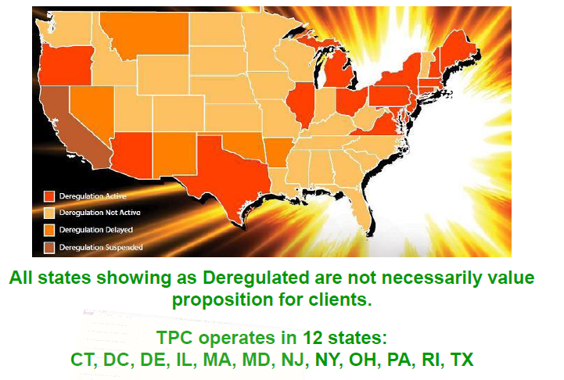
Map Of Deregulated States
TPC operates in 12 States:
CT, DC, DE, IL, MA, MD, NJ, NY, OH, PA, RI, TX

Slide 12
The Power Company Value Add
Experience
Industry Knowledge
Our team has been in the deregulated energy market for several years
Strong, long-standing relationships with the top Energy Suppliers in the industry
Executives have over 4 decades in the energy and the commodities markets
Experience in analyzing the movements and price patterns of the energy markets
Size
The Power Company's team has assisted over 2.5 million clients
TPC’s team has serviced in excess of 2 billion kwh (kilowatt hours) for our loyal clients
TPC’s team has serviced over $500,000,000 in energy billing in just the last 5 years
Because of our intricate knowledge of how the energy markets work, we bring suppliers to a level playing field. Our Energy Consultants are able to efficiently explain the energy markets so that our clients know exactly what they can expect.
Value
They/we own our contracts

Slide 13
Real Company Savings
$180,000
Estimated savings on 36 month term for a restaurant group
Saved in the first year for a food manufacturer/retailer
$67,000
$17,000
Estimated savings on 24 month term for a private club
$2,500
Savings for each location per month for auto dealership

Slide 14
“E^{3”}

Slide 15
“Energy Efficient Contracts:
Energy Efficient Motors
Complete lighting systems proprietary patented technology
Integrated adaptive controls/dashboard
High Performance Efficiency
Unique 100% Financing

Slide 16
Energy Efficient Solutions
REDUCTION OF ELECTRICITY FOR ARTIFICAL LIGHTING
CONTROL & SENSOR
MAXIMIZE LIGHTING EFFICIENCY
LIGHTING
EFFICIENT LIGHTING SYSTEMS TO MINIMIZE ELECTRICIAL COST
SKYLIGHTS
LIGHTING SERVICES

Slide 17
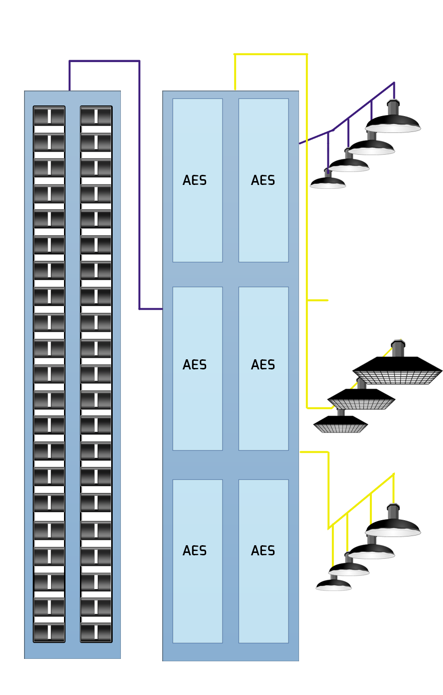
Proprietary Lighting Solution
Environmentally Sound
Reduces energy consumption of existing lighting systems 10% to 36%
Safety
Longer lamp life means lower maintenance costs
Versatile
Designed to work with a wide variety of HID lamps including low/high pressure sodium, metal-halide, mercury vapor, pulse start, etc.
Extends lamp life up to 40% and ballast life up to 200% reducing stress on landfills
RoHS compliant and 95% recyclable by weight
Maintains lumen output at or above rated specifications longer than uncontrolled lamps
Virtually maintenance free
Lighting Panel
E- Series Controllers

Slide 18
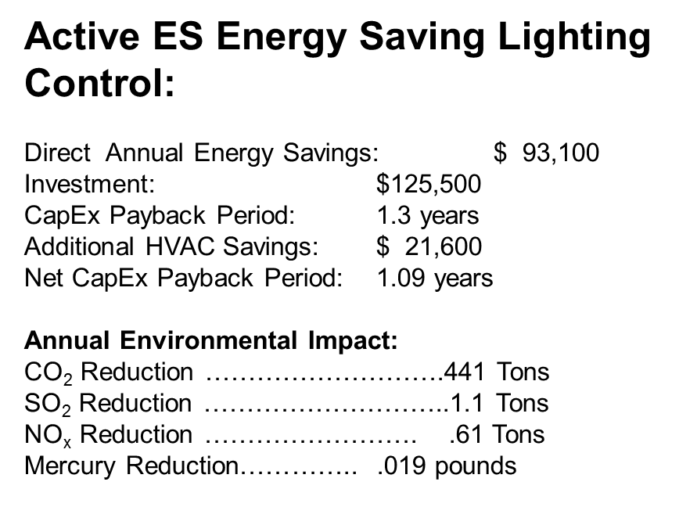
Proprietary Lighting Solution
E-Series Energy Saving Lighting Control:
E-Series lighting controls which were integrated into Nestlé's Dreyer’s Ice Cream’s Division freezer sections and parking lot areas of Dreyer’s Ice Cream distribution facilities in Manteca CA, City of Industry CA and Colorado Springs, CO.

Slide 19
Financing- Asset Management Program
The pie charts below represent the total utility expenses and cash flow for facilities before, during and after implementing Asset Management Program.
BEFORE
DURING
AFTER
$209,583
Cash flow
end user
$216,213
to Utility
$216,213
to Utility
$581,654
to Utility
$155,857
Cash flow end user
$155,858
to E³
Benefits
We retain Technology & Financial Risk.
We Own Assets During Term
Immediate Cash Flow Generation for all Parties
NO Up-Front Capital Required
We Deliver Guaranteed Savings
Not Recorded on Balance Sheet
Monthly Payments are Structures as Utility Expense

Slide 20
Why You And Wall Street Will Love Premier

Slide 21
Why You And Wall Street Will Love Premier
Step One Deregulation of Power
Is 7-10 times bigger than telecom deregulation on a huge up side as all 50 states must deregulate before 2020.
Simple to Understand
Professional marketers will be offering consumers lower cost power.
Warren Buffet Stated
“Power Deregulation will result in the biggest transfer of wealth in the history of the United States”
Whether or not a Power Sale is Made
The customer is introduced to E^{3.} So $0 cost for client procurement in the subsidiaries: “Continuous Revenue Stream”
Rollup Strategy
“TPC” compares to “The Lending Tree” in the Power Industry

Slide 22
Why You And Wall Street Will Love Premier
TPC Differentiators
Over 10,000 contracts in place (valued at $8M to $12M)
Multiple Suppliers (20+ and counting)
Pioneers of Deregulation (Helped deregulate the City of Dallas)
E³
Top Management
Government Expertise
Integration Expertise
Commodity Expertise
Power Portal -first of its kind
Compliance – Our goal is to be an industry leader in compliance
Proprietary Technology
100% Financing
Strategic Relationships
Continuous Revenue Stream
GEXPRO
Orion
Firestone

Slide 23
Why Your Investors Will Be Interested In PRHL
Most Investors either institutional or individual are motivated by fear, hope, and greed.
THEY……
Fear
that they will miss out on a opportunity 7 times bigger than Telecom
Hope
they are in on the ground floor of an expanding market, and
Greed
pushes them to participate in the greatest transfer of wealth in the US history.

Slide 24
Thank you
FSX and the Broker-Dealer Community .
Congratulations on your 30th Anniversary!
“If you believe we will continue to use power and at the same time increase conservation efforts - Then both you and your clients should own PRHL.”
1382 Valencia Avenue •Suite F •Tustin• CA 92780 •Tel: 949.260.8070
www.PRHLcorp.com

